Slide 1

Information Architecture

Slide 2
Today’s Content
Information architecture
Tree testing
Sitemap & Wireframe

Slide 3
Information Architecture
Information architecture (IA) focuses on organizing, structuring, and labeling content in an effective and sustainable way.
The goal is to help users find information and complete tasks.
To do this, you need to understand how the pieces fit together to create the larger picture, how items relate to each other within the system.
---usability.gov
https://www.usability.gov/what-and-why/information-architecture.html

Slide 4
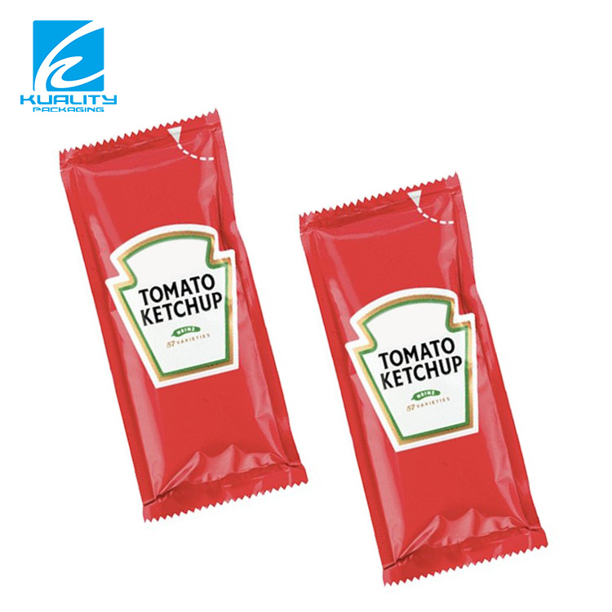
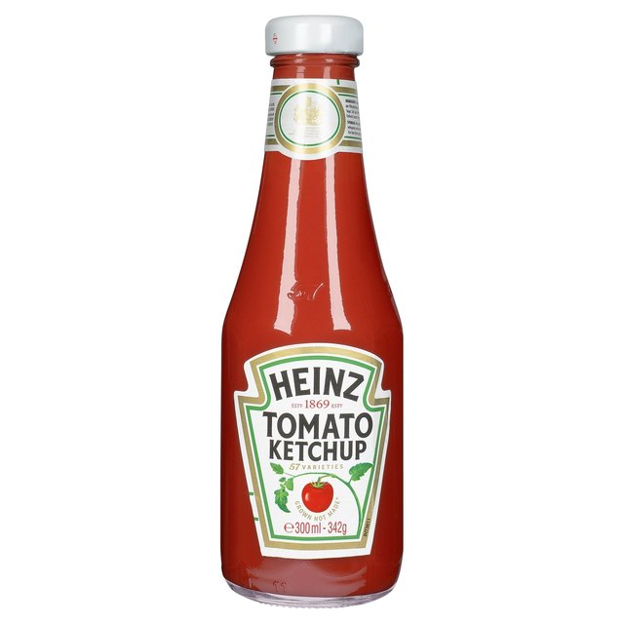
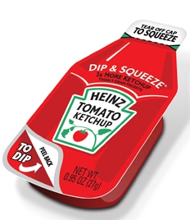
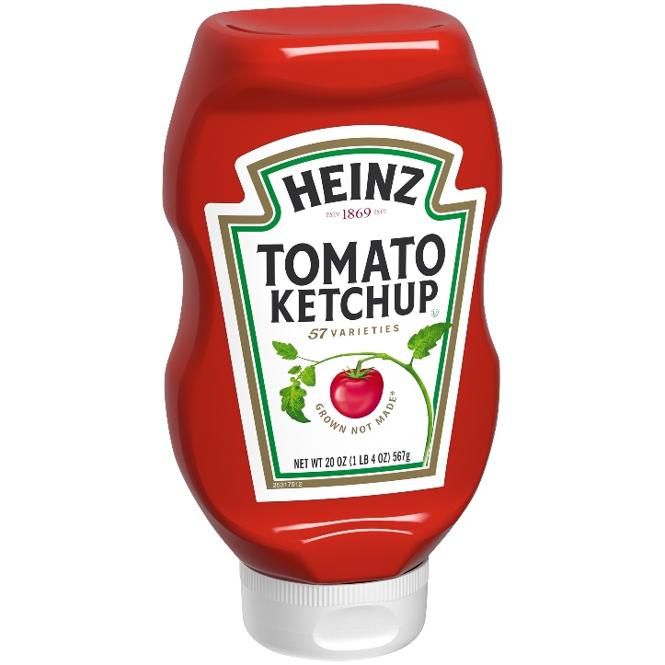
Information architecture is design thinking applied to customer-centric problems
https://www.youtube.com/watch?v=qcSAvBl85rk
https://www.youtube.com/watch?v=Ytv21Jx0hD4

Slide 5

There are only 5 ways to organize things
L
A
T
C
H
Founder of Ted Talk
---Richard Saul Wurman
Notes:
https://www.youtube.com/watch?v=qGFF_FhNdY4

Slide 6
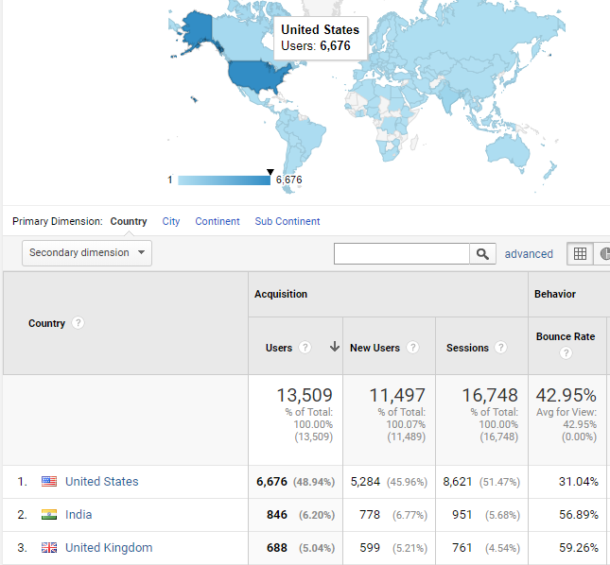
L
Location

Slide 7

With the rise of VR/AR technologies, organizing information based on location is becoming very important aspect of Information Architecture.
https://uxplanet.org/design-principle-organizing-information-343a7ef936a8

Slide 8
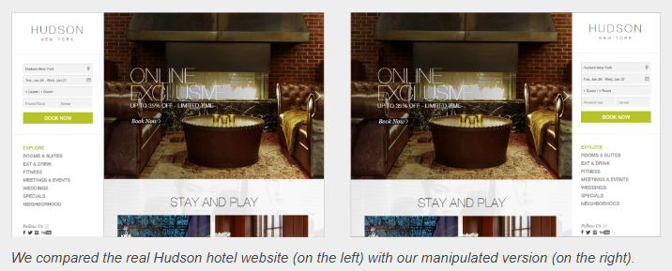
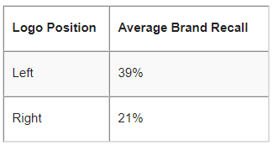
Left vs. Right Logo Placement

Slide 9
Logo Placement Affects Web Navigation and Brand Recall (Kathryn Whitenton)
https://www.youtube.com/watch?v=xo6CHO49XKk

Slide 10
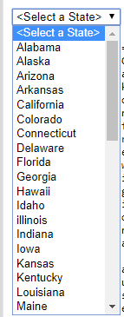
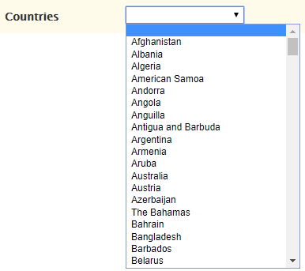
Alphabet
A
https://www.nngroup.com/articles/alphabetical-sorting-must-mostly-die/

Slide 11
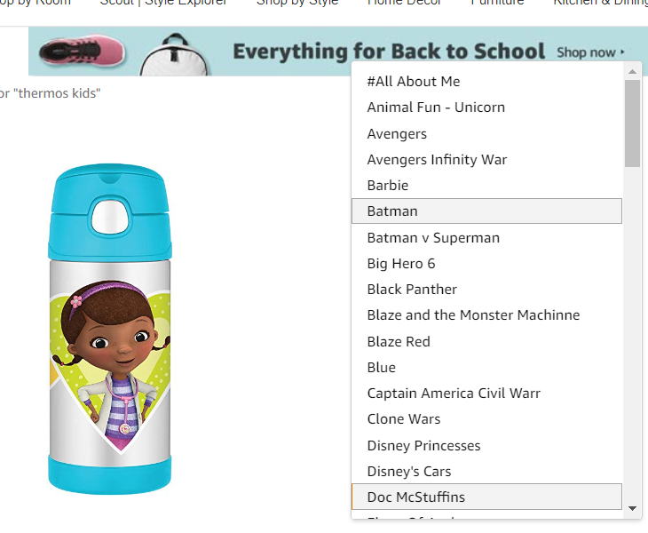
Desktop

Slide 12
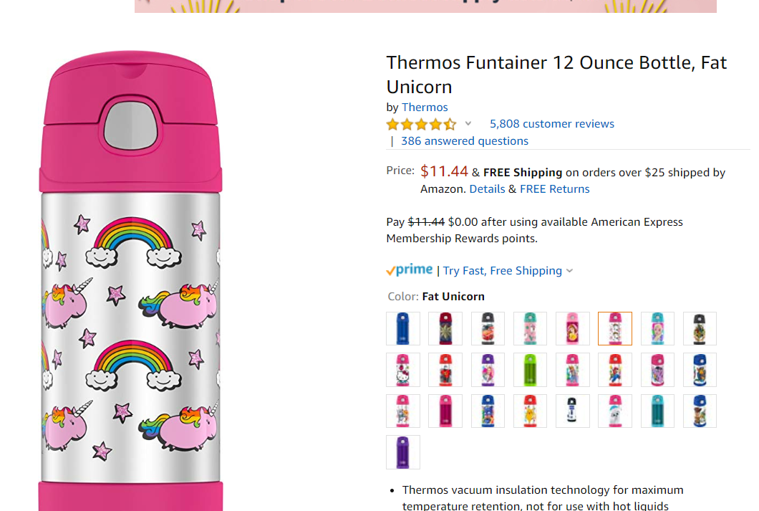
What they have now
https://www.amazon.com/Thermos-Funtainer-Ounce-Bottle-Unicorn/dp/B078HDR9GD/ref=sr_1_4?keywords=thermos+water+bottle+kids&qid=1567541453&s=gateway&sr=8-4

Slide 13
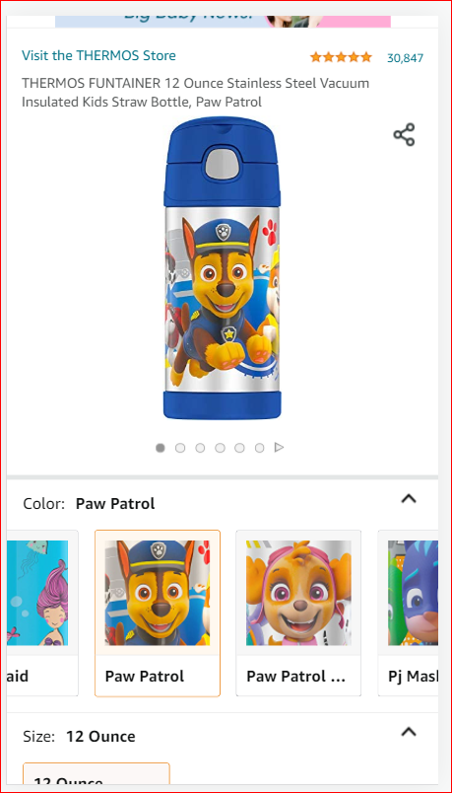
Mobile

Slide 14
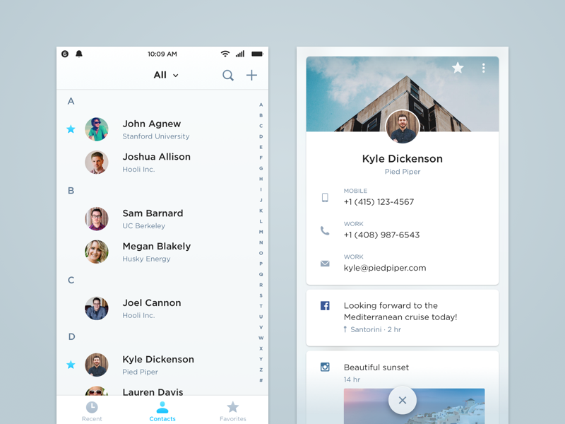
https://uxplanet.org/design-principle-organizing-information-343a7ef936a8

Slide 15
People Rarely Think A–Z
Lists of countries and other known-item problems are also often fine to alphabetize. However, you do need to ensure that users will know unambiguously the name of their selection.
e.g., list of your names in alphabetic order by last names
For most questions, either
users don't know the name of the thing they want, making A–Z listings useless; or
the items have an inherent logic that dictates a different sort order, which makes A–Z listings directly harmful because they hide that logic.
https://www.nngroup.com/articles/alphabetical-sorting-must-mostly-die/

Slide 16
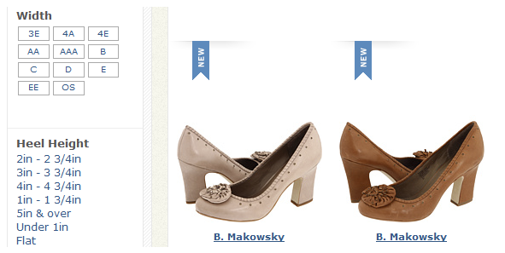

Slide 17
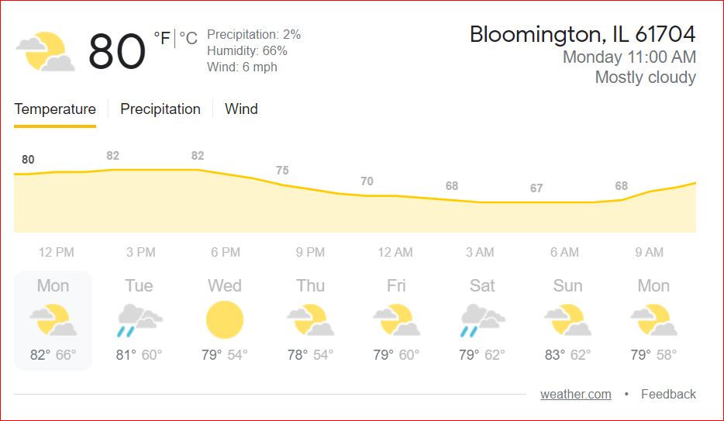
T
Time

Slide 18
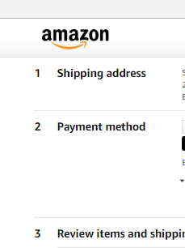
Time-based sequence (step-by-step procedures)

Slide 19
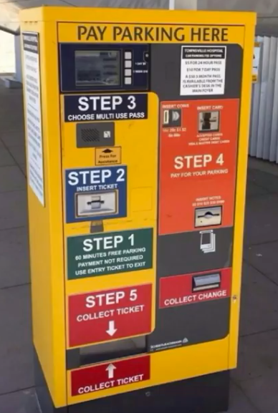
Notes:
https://www.youtube.com/watch?v=qGFF_FhNdY4

Slide 20

C
Category

Slide 21
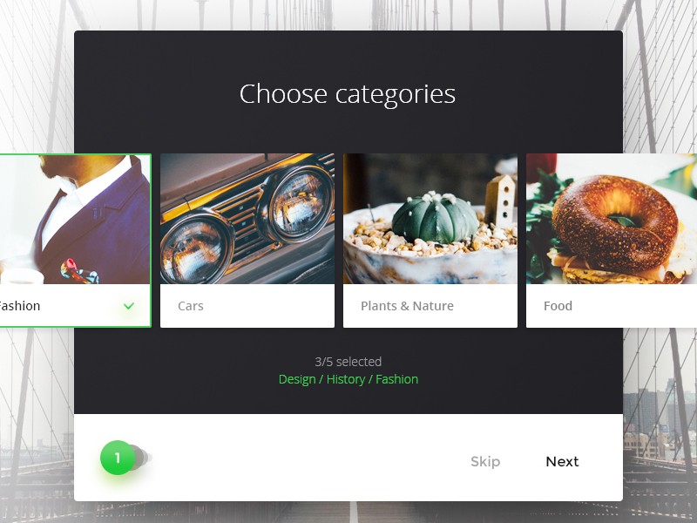
Category

Slide 22
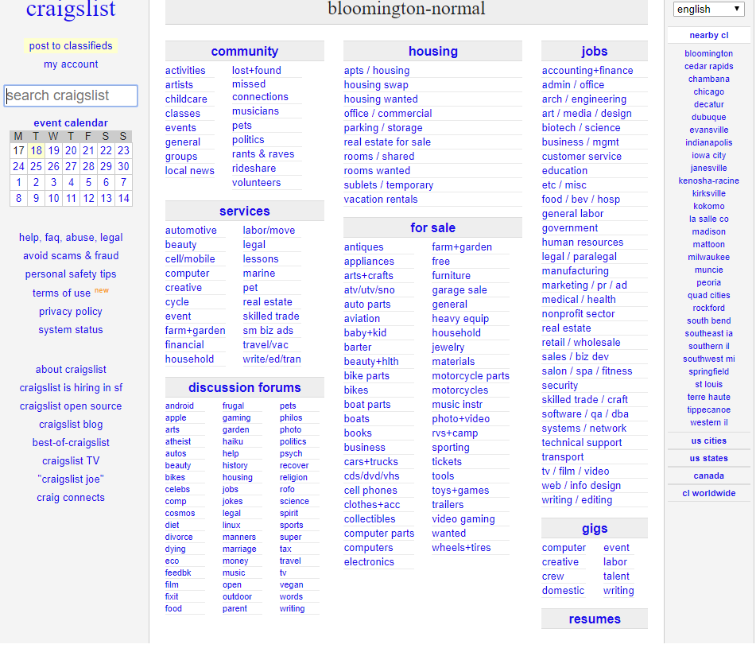

Slide 23

H
Hierarchy

Slide 24
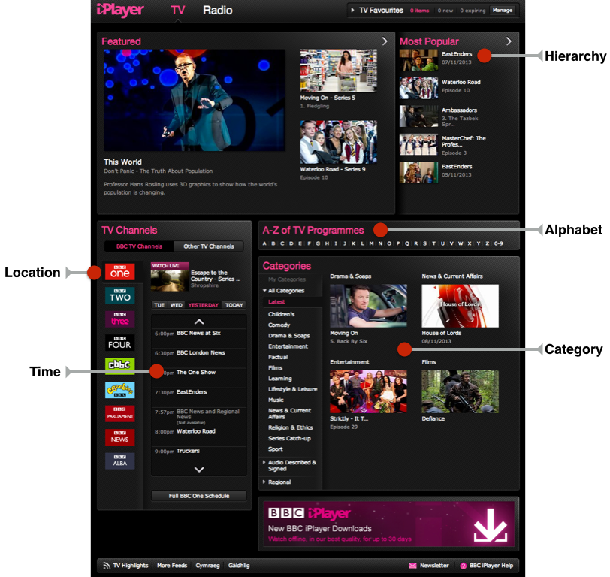
Putting them all together

Slide 25
There are only 5 ways to organize things
Location
Alphabet
Time
Category
Hierarchy
---Richard Saul Wurman
Notes:
https://www.youtube.com/watch?v=qGFF_FhNdY4

Slide 26
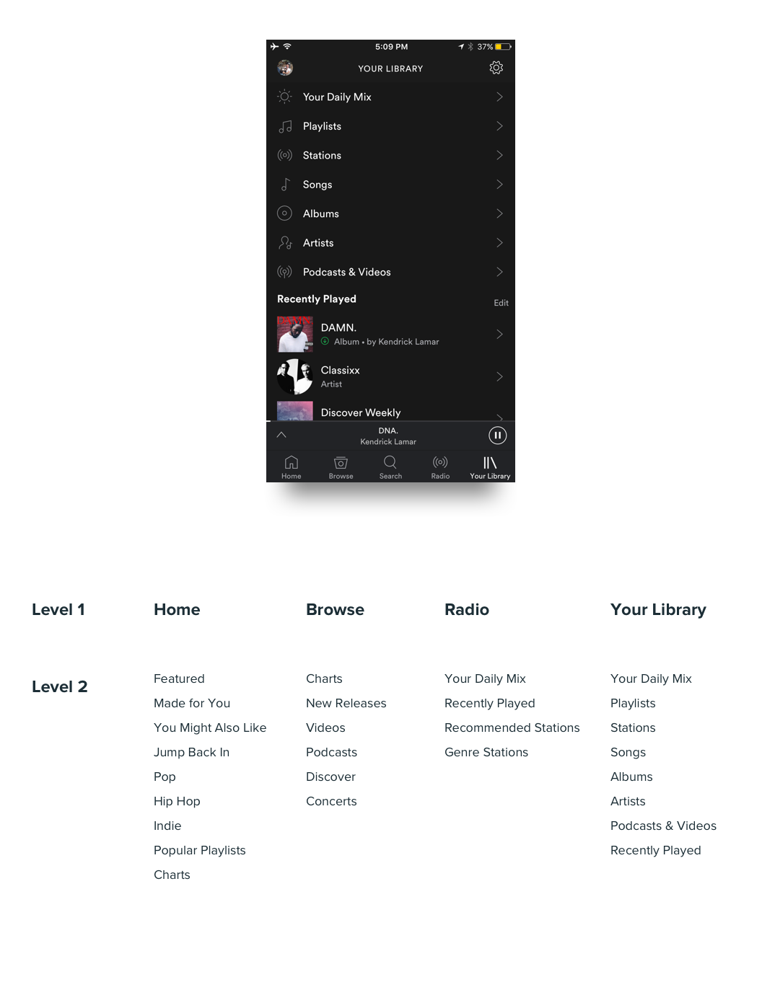
Information Architecture of Spotify

Slide 27
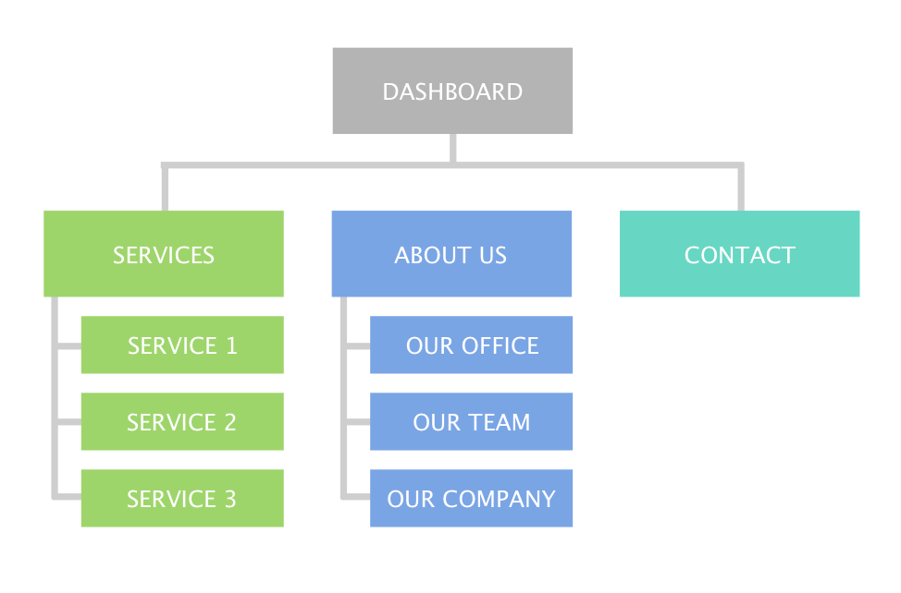
https://brainhub.eu/blog/information-architecture/

Slide 28
Information Architecture (IA) = Navigation ?
IA is the information backbone of the site;
navigation refers to those elements in the UI that allow users to reach specific information on the site.
https://www.nngroup.com/articles/ia-vs-navigation/

Slide 29
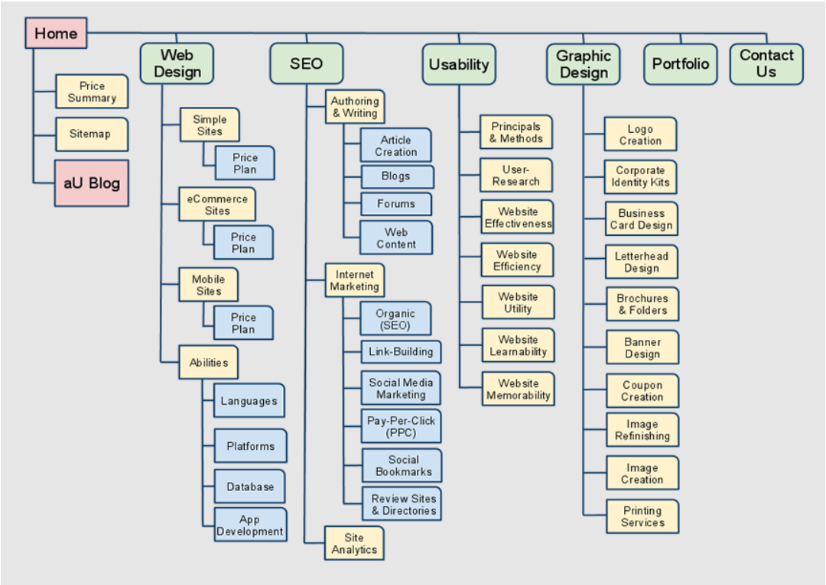
http://www.affordableusability.com/sitemap.html

Slide 30
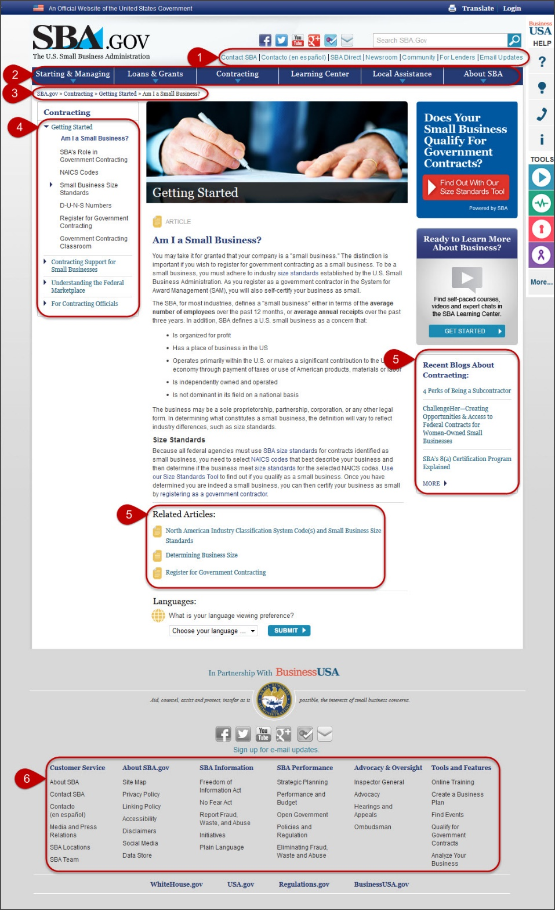
1) utility navigation;
2) global navigation;
3) breadcrumb trail;
4) local navigation;
5) related links (in this case, articles and blog posts);
6) fat footer.

Slide 31
Do we still need Information Architecture (IA) when users can just search?
https://www.youtube.com/watch?v=ylvITZEAHX0

Slide 32
Tree Testing

Slide 33
Tree Testing (reverse card sorting)
A tree test evaluates a hierarchical category structure, or tree, by having users find the locations in the tree where specific tasks can be completed.
https://www.optimalworkshop.com/treejack
https://www.nngroup.com/articles/tree-testing/

Slide 34
Try a Tree Testing Demo
https://bananacom.optimalworkshop.com/treejack/bananacom-demo-survey

Slide 35
Sitemap

Slide 36

Visual Sitemap
A 2D image or drawing representing the structure of a website.
Pages are represented as blocks and cells linked together in a hierarchical organizational chart.

Slide 37
http://www.affordableusability.com/sitemap.html

Slide 38

HTML Sitemap
HTML formatted sitemaps are typically used for human interaction and understanding of page content locations within a website.
HTML sitemaps may be included as a page on a website as an additional navigation aid.

Slide 39
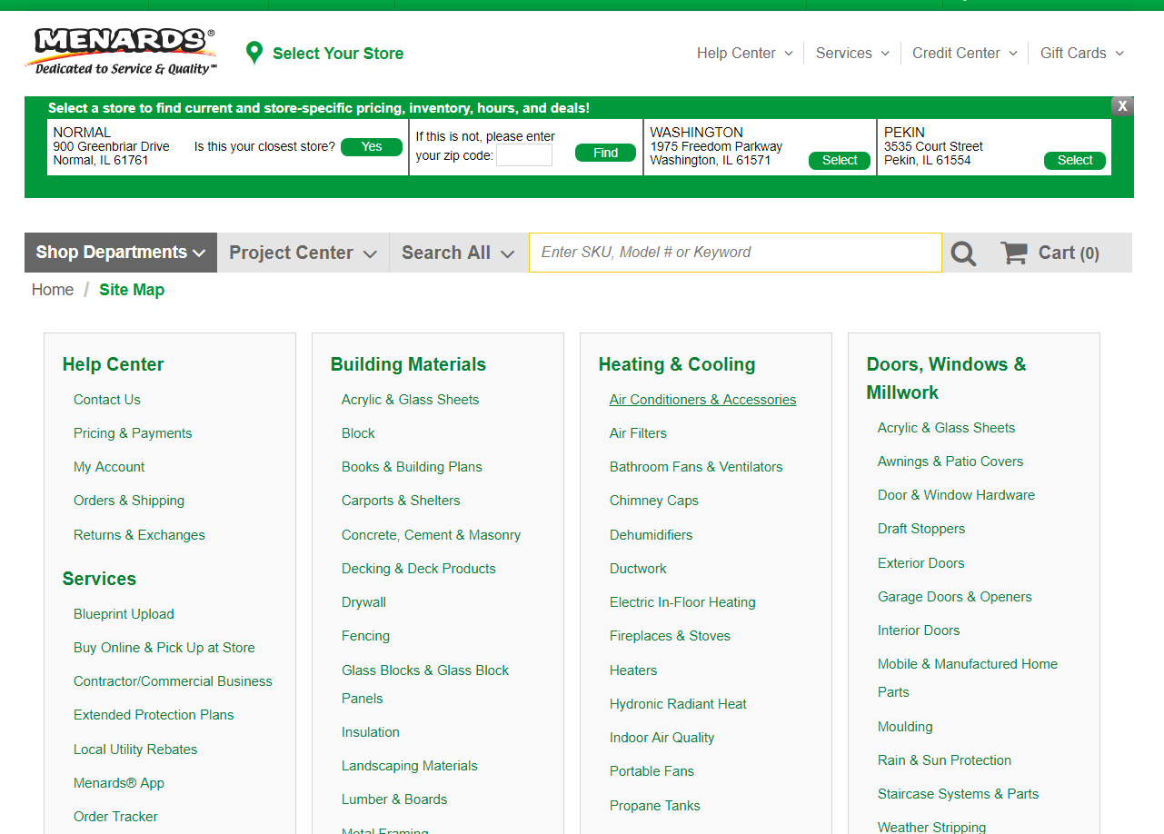
https://www.menards.com/main/sitemap/c-3580.htm

Slide 40
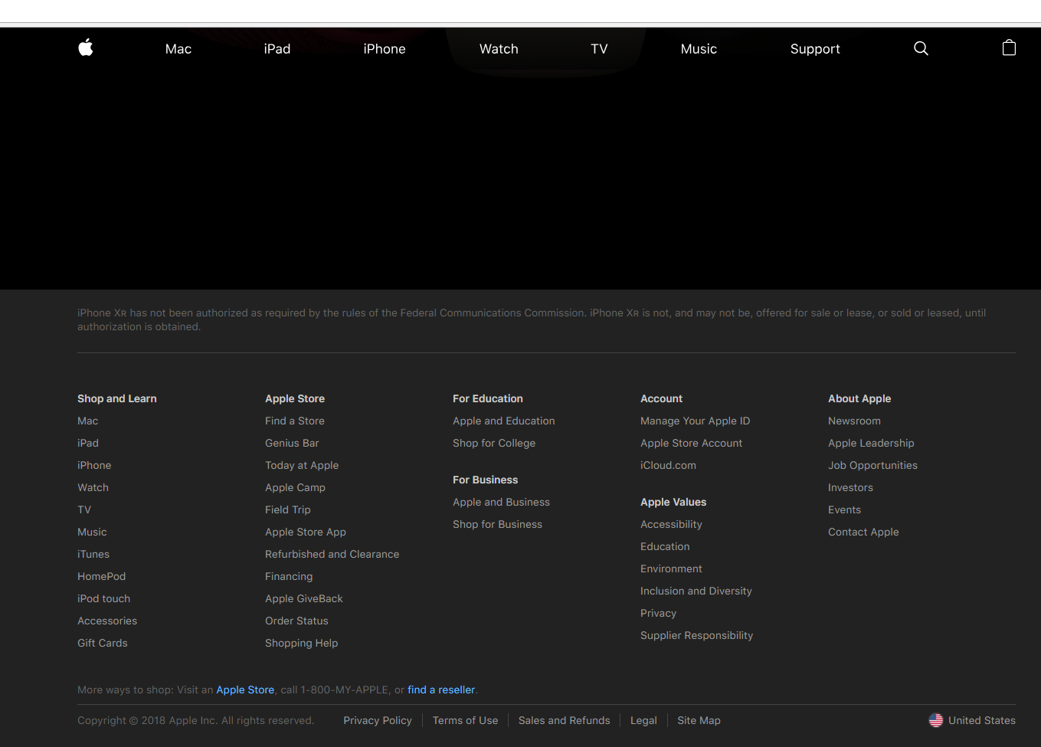

Slide 41
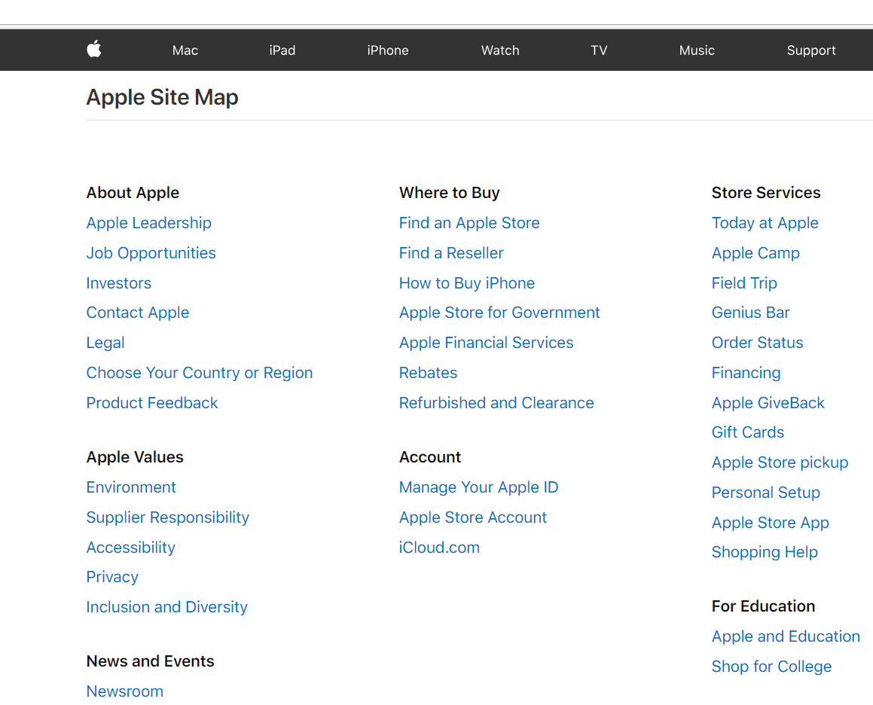

Slide 42

XML Sitemap
An XML formatted list of pages readable by search engines such as Google, Bing, and Yahoo.
Submitting XML sitemaps to search engines allows for better and more comprehensive website indexing.

Slide 43
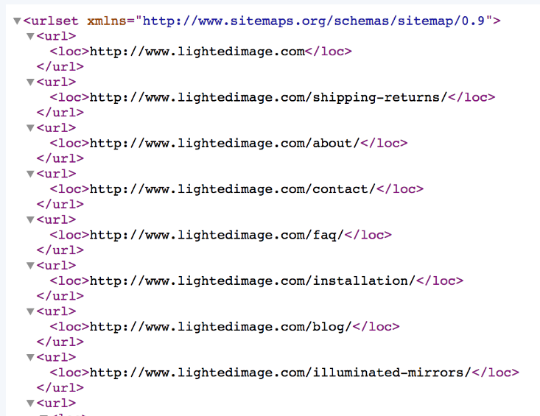

Slide 44
Wireframe

Slide 45
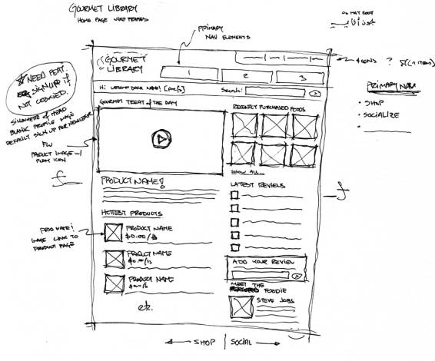
Wireframe
A website wireframe, also known as a page schematic or screen blueprint, is a visual guide that represents the skeletal framework of a website.
Notes:
https://www.interaction-design.org/literature/article/ux-tools-wireframing-and-prototyping-tools

Slide 46
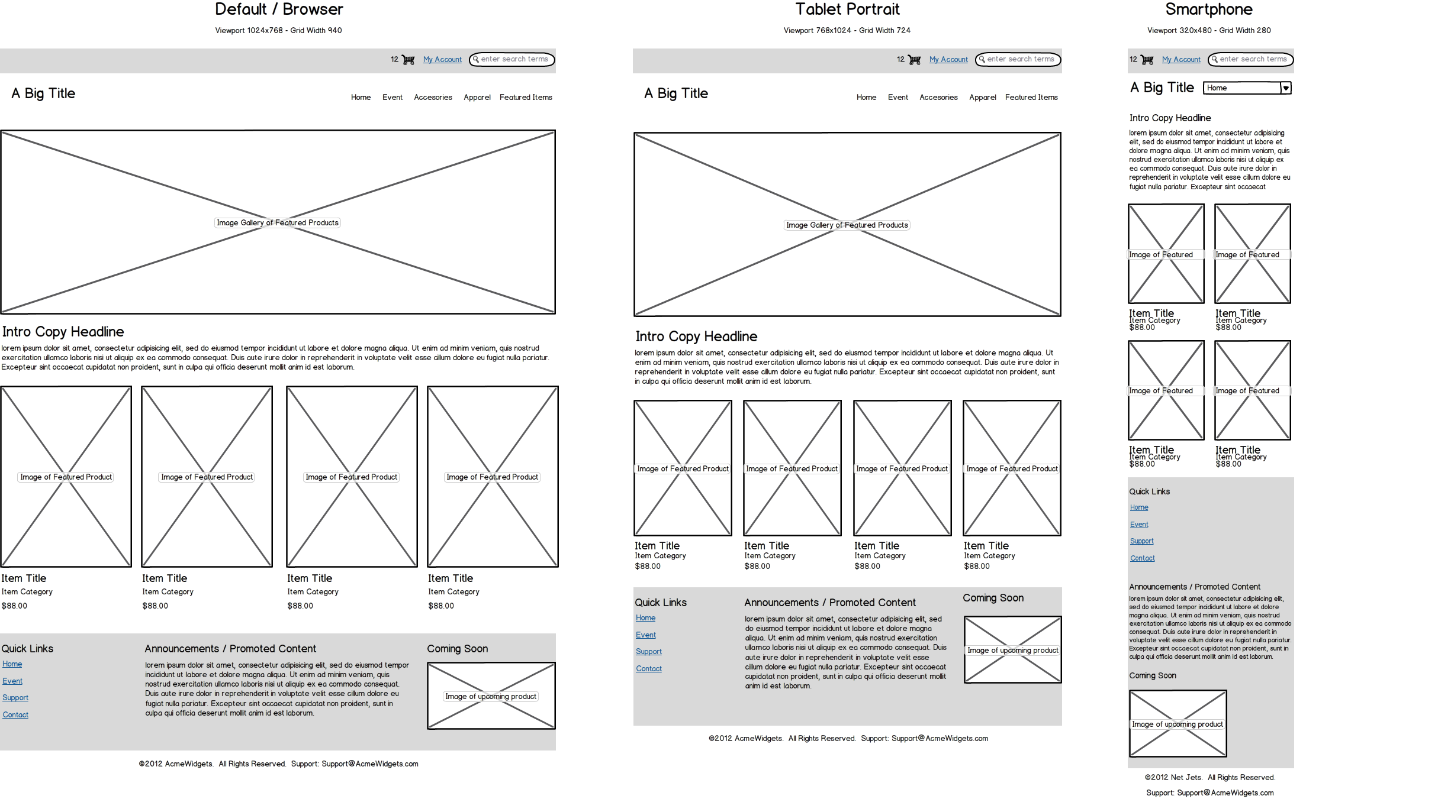

Slide 47
Something to read
Top 10 Information Architecture (IA) Mistakes
https://www.nngroup.com/articles/top-10-ia-mistakes/
5 Information Architecture Warning Signs in Your Analytics Reports
https://www.nngroup.com/articles/ia-warning-signs-analytics/

Slide 48
Individual assignment1 & 2 are due Wednesday

